Slide 1
Identifying Key Issues and Trends Related to a Country from News Reports

Slide 2
Table of contents
Key Findings
Key Issues
Time Analysis
Entities Analysis
News Outlet Analysis
Methodology
Overview
How to represent an issue
Topic model
Tuning topic model
Text data cleaning
Other analysis

Slide 3
Key Findings

Slide 4
Top 5 Key Issues
Issue | Representative Keywords | Examples (title)
1 | Cases, said, coronavirus, people | 17 foreign, two Indian participants of Nizamuddin discourse found in Bahraich: Official Latest coronavirus update: Tamil Nadu sees big jump, 57 positive cases
2 | Market, company, Indonesia, business | Indonesian startups ProSpark, Webtrace raise funding to expand ops The return of the Indonesian MotoGP
3 | Sea, China, crew, fishing | Hundreds of Indonesian crew members flying in from Italy skip quarantine after testing negative for COVID-19 Coronavirus: Obese cruise passenger unable to fly home to sail from Australia to Germany
4 | Flights, airlines, air, China | Saffers stuck in Indonesia say Emirates and SA Embassy very unhelpful How can Britons abroad get on rescue flights back to the UK? Latest coronavirus travel advice
5 | Australia, Papua, Dutch, Indonesia | Perth man charged for failing to self-isolate Tom Bradby's great Australian odyssey

Slide 5
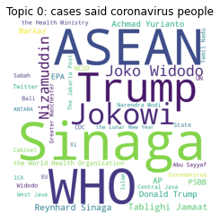
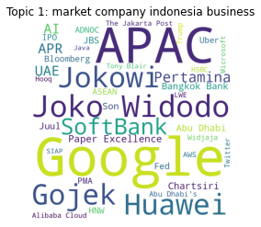
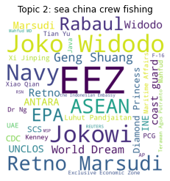
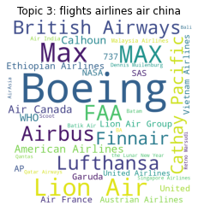
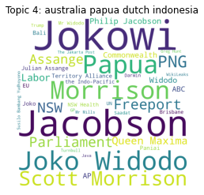
Prominent Entities Per Topic
Entities provide us more details on issues. Top 5 issues shown below.
Note: Entities exclude location, numerical entities

Slide 6
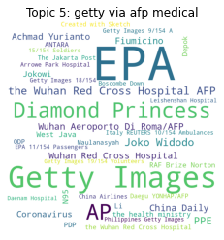
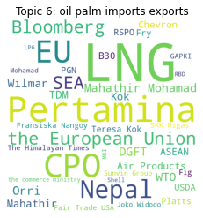
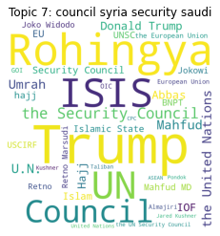
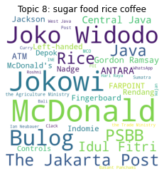
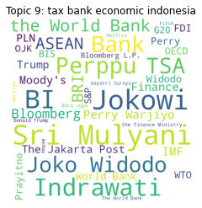
Top 5 to 10 topics
Barito Pacific donates Rp 30 billion worth of medical devices to hospitals
Trade war proves a boon for apparel
Komnas HAM: ISIS Militants Must be Held Accountable Under the Law
Japanese cuisine on a roll in Indonesia
Indonesia taxes tech companies through new regulation

Slide 7
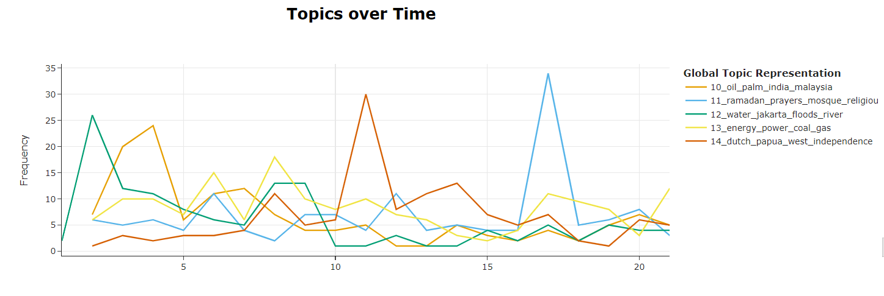
Key Issues In Specific Timelines
Examples of key issues that occurs in specific timeline can be gleaned using time series plots:
Dispute regarding Dutch New Guinea
Ramadan occurring in Apr
Flooding in start of Feb in Jakarta
Palm oil dispute possibly with the listed countries
Week number

Slide 8
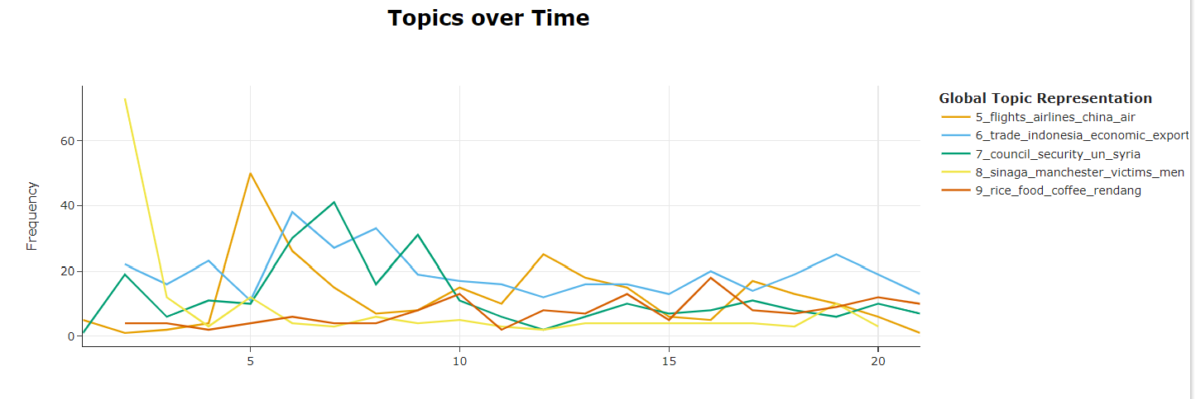
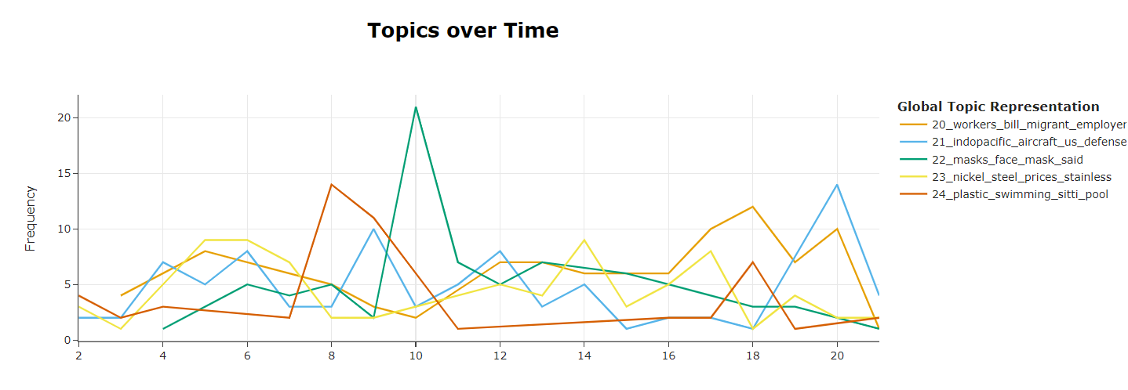
Key Issues in specific Timelines
Crime news don’t tend to persist across time
Week number
Face Mask Issues in the middle of the pandemic
Week number

Slide 9
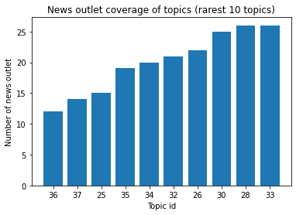
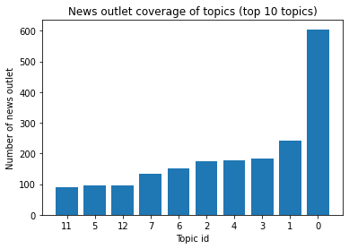
Topics and News outlet
No topic is only reported by one news outlet, but there are topics which few news outlets report.
While top issues are usually reported by many news outlets, some news outlet a particular issue more frequently.
36_kashmir_jammu_srinagar_positive
37_poor_households_effendy_muhadjir
25_jiwasraya_insurance_bpjs_insurer
35_brands_brand_products_beauty
34_monash_university_universities_students
32_crocodile_tire_reward_reptile’
26_court_mco_jail_wto
30_village_ghosts_haunted_pocong
28_relations_cooperation_bilateral_indonesia
33_prisoners_inmates_prison_release
11_species_conservation_animals_forest
5_getty_via_medical
12_data_information_users_tiktok
7_council_syria_security_saudi
6_oil_palm_imports_exports
2_sea_china_crew_fishing
4_australia_papua_dutch_indonesia
3_flights_airlines_air_china
1_market_company_indonesia_business
0_cases_said_coronavirus_people

Slide 10
Methodology

Slide 11
Overall Methodology
Data Understanding
What is the distribution of each data field, and across time?
Can we extract some features (NER, keywords, sentiments) to understand text data?
Literature Review
What does the common methods to tackle this problem?
Modelling (Unsupervised)
Cluster articles into similar topics + extract keywords per topic
Data Cleaning
Perform model selection
Model tuning
Further Analysis
Keyword selection
Time series analysis
News outlet analysis
Filtering for related news

Slide 12
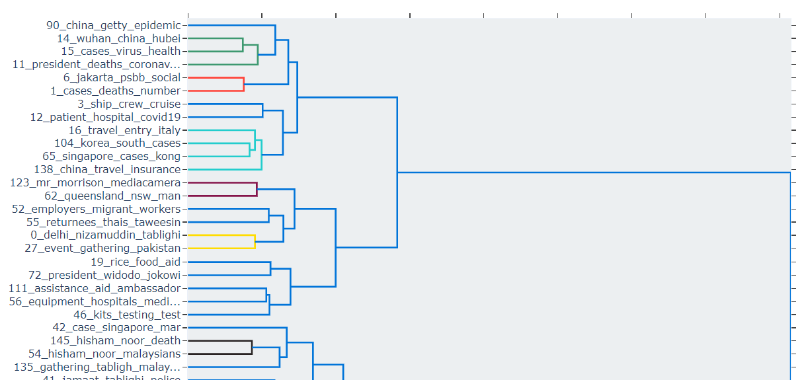
How To Represent a Topic or issue
Key Phrases
Hierarchy and Combination
Sentence
Example: Covid-19, economy
How can we extract key phrases?
Document level
Graph algorithms: TextRank [1]
Zero shot summarization [2]
NER [3]
Cluster of Documents
- Topic modelling: LDA [4], NMF[4], BERTopic[5]
Example: Economy under covid-19 (which is under health
How?
Topics and sub-topics classification (IAB) [6]
Hierarchical clustering (Topic models) [5]
Example: Covid-19 have resulted in economic downturn in the tourism industry.
Zero-shot Summarization of a cluster of documents
Extraction of key sentences per article
(not performed)
- Utilize an example article
Notes:
[1] Mihalcea, R., & Tarau, P. (2004, July). Textrank: Bringing order into text. In Proceedings of the 2004 conference on empirical methods in natural language processing (pp. 404-411).
[2] Duan, X., Yin, M., Zhang, M., Chen, B., & Luo, W. (2019, July). Zero-shot cross-lingual abstractive sentence summarization through teaching generation and attention. In Proceedings of the 57th Annual Meeting of the Association for Computational Linguistics (pp. 3162-3172).
[3] Schmitt, X., Kubler, S., Robert, J., Papadakis, M., & LeTraon, Y. (2019, October). A replicable comparison study of NER software: StanfordNLP, NLTK, OpenNLP, SpaCy, Gate. In 2019 Sixth International Conference on Social Networks Analysis, Management and Security (SNAMS) (pp. 338-343). IEEE.
[4] Alghamdi, R., & Alfalqi, K. (2015). A survey of topic modeling in text mining. Int. J. Adv. Comput. Sci. Appl.(IJACSA), 6(1).
[5] Grootendorst, M. (2022). BERTopic: Neural topic modeling with a class-based TF-IDF procedure. arXiv preprint arXiv:2203.05794.

Slide 13
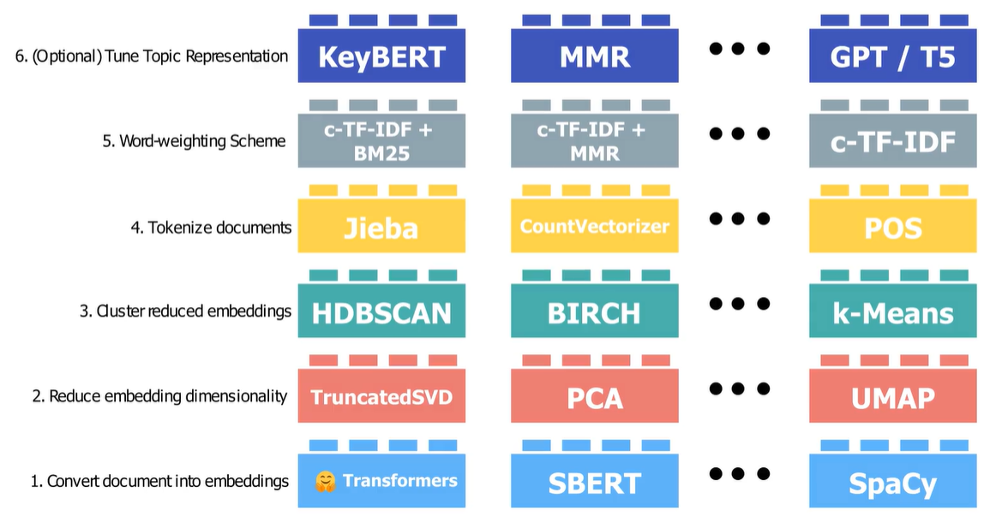
Topic Model Utilized
Why BERTopic is utilized?
Explainable models include NMF and BERT
Coherence Score is poor (0) for NMF
Ability to utilize embeddings
Notes:
Coherence Score - measures the degree of semantic similarity between the top words in a topic (Using TF-IDF)
For example, if a topic consists of the words "apple, fruit, tree, red, and sweet," the coherence score would measure how well these words are related to each other in a semantic sense.
In NMF, the matrix of term frequencies in the documents is factorized into two non-negative matrices - a document-topic matrix and a topic-term matrix.
LDA works by iteratively updating two sets of parameters - the topic-term matrix and the document-topic matrix - until a stable solution is obtained. The algorithm starts by randomly assigning each word in each document to one of the topics, and then iteratively updates the probability distributions until convergence. During each iteration, the algorithm computes the probability of each word in each document belonging to each topic and updates the document-topic matrix accordingly. It then computes the probability of each term belonging to each topic and updates the topic-term matrix accordingly.
In c-TFIDF, the term frequency of a term in a document is weighted by its inverse document frequency, as in the traditional TFIDF scheme. However, the inverse document frequency component is also weighted by a measure of the context in which the term appears. The context is defined as the set of other words in the document that co-occur with the term.
KeyBERT works by first embedding each sentence in the document using a pre-trained BERT model. It then calculates the sentence embeddings' similarity scores to each other to identify sentences that are most semantically similar to each other. The algorithm then selects the top-n most similar sentences and extracts the keywords from these sentences using another pre-trained BERT model.
HDBScan works by first constructing a hierarchical representation of the data using a minimum spanning tree, which connects the data points with the shortest possible distances.

Slide 14
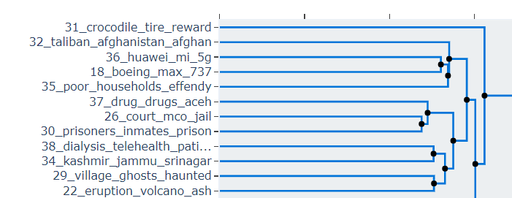
Tuning Topic Models
Outlier Documents
We can utilize similarity (c-TF-IDF vs BERT) to bring re-assign outlier documents to similar clusters
Number of Topics
Number of topics could be auto-assigned by BERTopic (158 topics) based on coherence score. However, it is hard to interpret so many topics
Reduce the number of topics gradually (158 -> 40) while keeping coherence score at a high level (0.68 -> 0.68)
Use hierarchical charts to determine if topics can be further combined.
Rice sugar coffee rendang
Nickel coal mine oil China

Slide 15
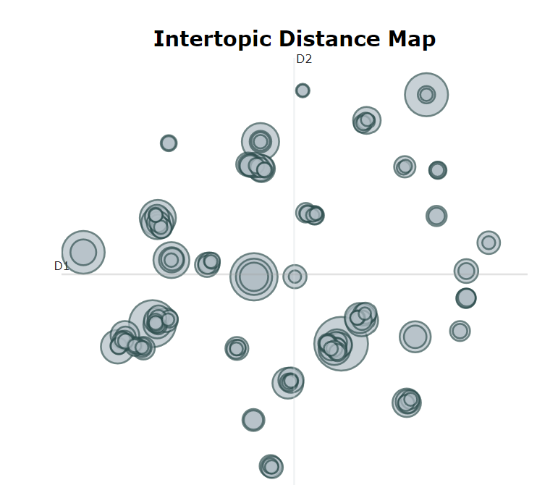
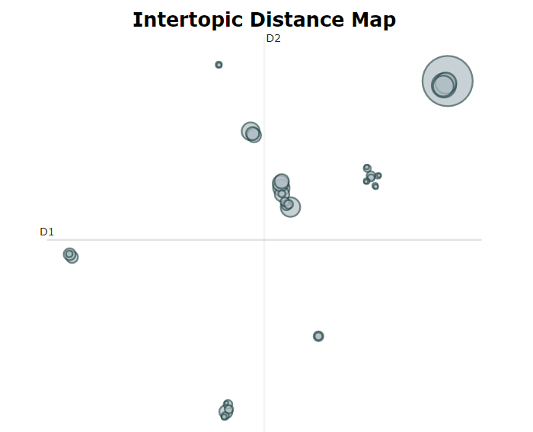
Tuning Topic Models
Number of Topics
Evaluate the improvement via the intertopic-distance maps
Before
After
Covid | Cases | Health | People
Sinaga | Manchester | Victims

Slide 16
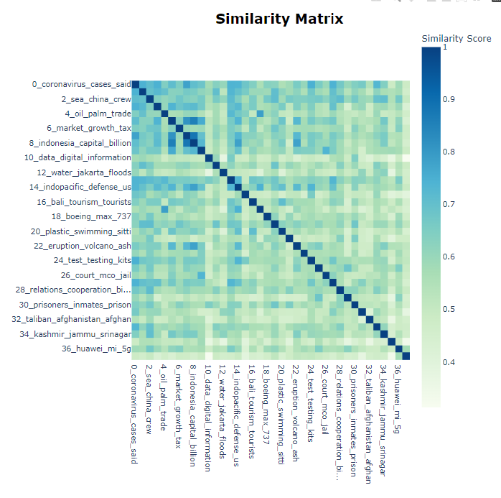
Tuning Topic Models
Number of Topics
Are there still any similar articles which we can combine?
Yes, however, it may not make sense to combine them. Ie covid19 + economy vs economy + banks
Can manually combine topics like power|energy|coal and oil|palm|trade, but there are not many to combine
Total about 38 topics identified

Slide 17
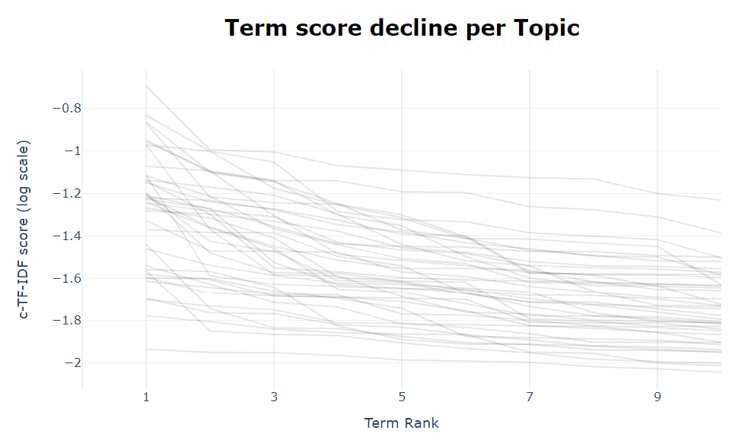
Tuning Topic Models
Number of Keywords
- Utilize c-TF-IDF score and elbow charts to determine the appropriate cut-off for keywords (4, globally)

Slide 18
Text Data Cleaning
Text data cleaning depends on the output of the specific analysis to be provided
For example, for BERT models, there are less data cleaning which needs to be done.
In general data cleaning steps include:
Remove URLs (usually not relevant to the analysis) (BERTopic)
Removing new lines (BERTopic)
Removing stop words (BERTopic)
Stemming (removing suffixes)
Lemmatizing (converting to base form)

Slide 19
Filtering for Related News
News related to Indonesia could be:
Local news
News which impact Indonesia/Indonesians (harder to evaluate)
Methods:
We look at the entities / keywords surrounding Indonesia using NER spacy library and textrank
Negative approach to reduce false positive – topics that have articles with few key words related to Indonesia, we will eliminate them
Result:
- Topic related to ('Taliban', 'Afghanistan’) is removed from list of topics

Slide 20
Other Analysis
Are there any other features within the text which can be utilized to gleam more information on the issues?
NER – using spacy library
Keywords – utilize textrank /positionrank model
IAB Classification using zero shot models
How?
We have the topic cluster assignment for each document in topic modelling. We can look at the top features extracted from topic models for each cluster.

Slide 21
Normalizing News outlet coverage
There are 430 “duplicated” articles based on titles, which could be excluded
Question: What constitutes a key or important issue?
Number of news outlet reporting on the same topic
Number of articles of the same topic per news outlet
Number of viewers viewing the same topic (not available)
Impact of news article on the user (hard to measure)
Therefore, news outlet coverage can be normalized if we have other features available.

Slide 22
Further Work
Manual merging of topics to prevent false positives
Tune number of keywords per topic
Glean more insights from article classification (zero shot) using IAB level 1 and 2 labels
Removal of location and organizational entities within topic keywords and provide a separate analysis for these entities
Craft sentence representation of topics by using graph-algorithms for key sentence extraction and zero-shot summarization

